Slide 1
Salesforce Data Access
QQ: 964186836

Slide 2
Agenda:
System Access – IP Range & Login Hour
Object Access – Profile & Permission Set
Field Access – Field Level Security
Record Access – OWD, Role Hierarchy & Sharing

Slide 3
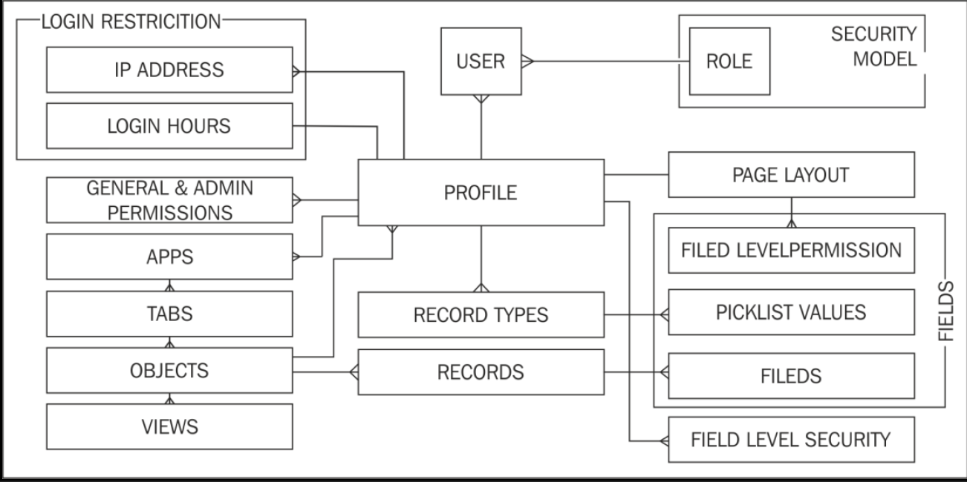

Slide 4
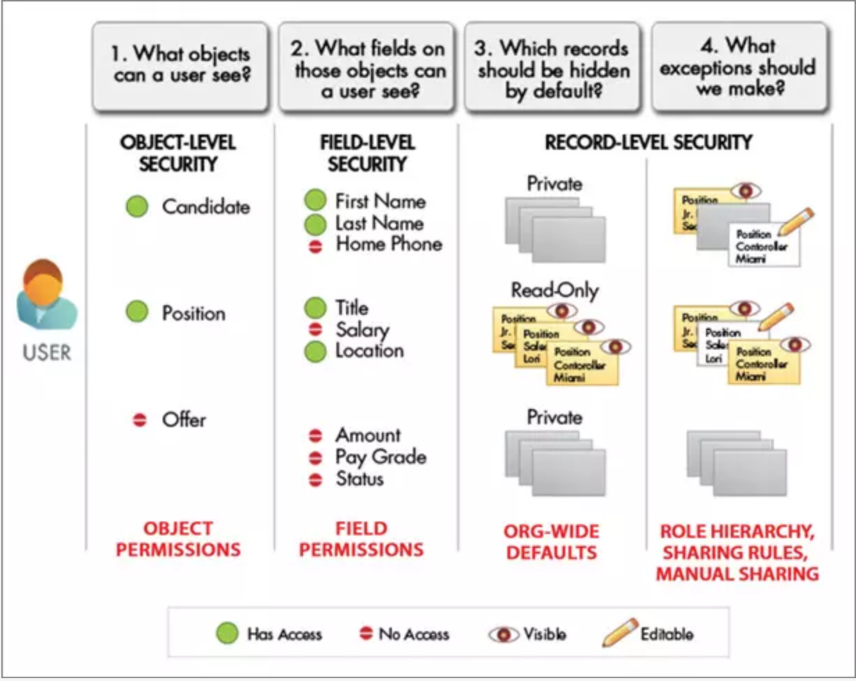

Slide 5
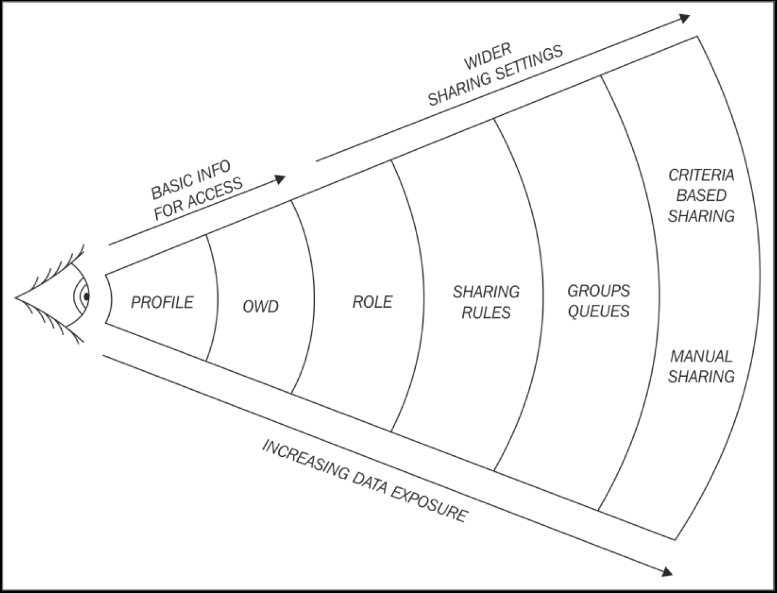

Slide 6
OWD
Private
Public Read Only
Public Read/Write
Controlled by Parent
Grant Access Using Hierarchies

Slide 7
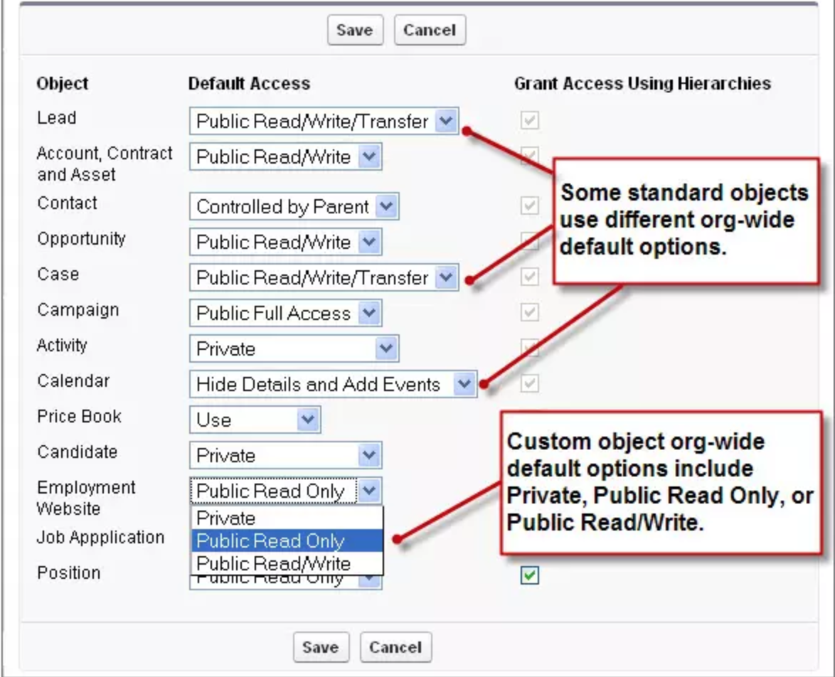

Slide 8
 | Profile/Permission Set | 不属于你的记录
 | Object Setting | OWD | Role Hierarchy
Account | CRED | private | View + Edit
Contact | CR | Public Read/Write

